Slide 1
General viva Presentation
CCE-4832
computer and communication engineering

Slide 2
GROUP 04
Submitted By:
E193009 Zia Ul Hassan Chowdhury

Slide 3


COURSE
Artificial Intelligence (CCE-4803)
Machine Learning (CCE-4829)
Fiber Optic Communication (CCE-4801)

Slide 4
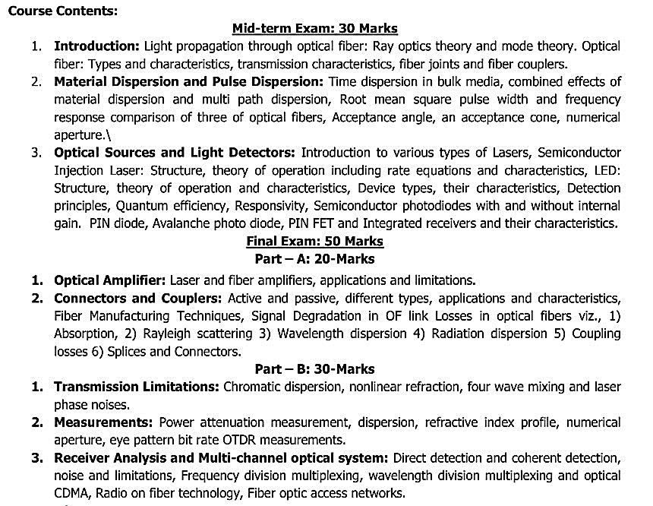
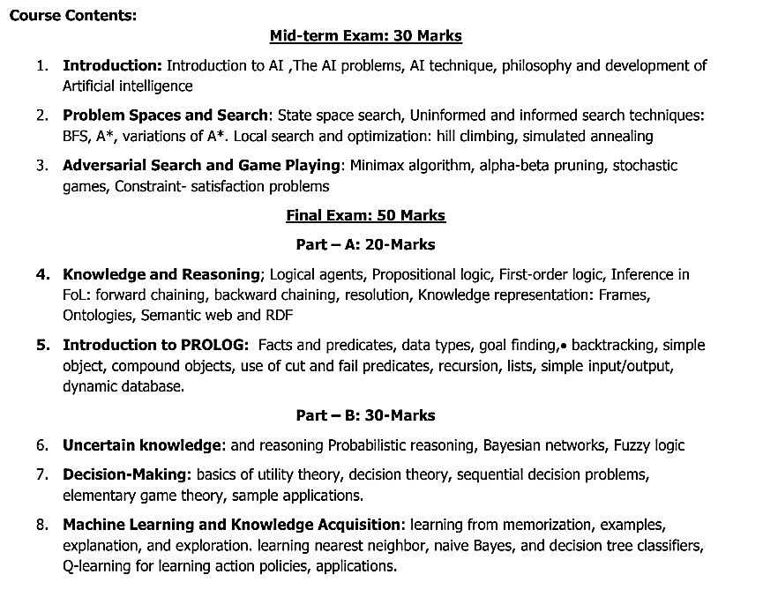
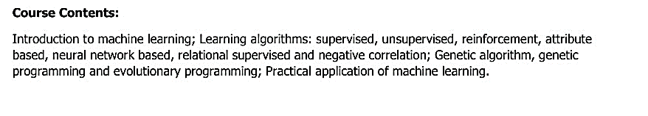
SYLLABUS
Machine Learning (CCE-4829) Artificial Intelligence (CCE-4803) Fiber Optic Communication (CCE-4801)
Effects of exposure

Slide 5
Machine learning
Contents
INTRODUCTION TO MACHINE LEARNING;
LEARNING ALGORITHMS: SUPERVISED, UNSUPERVISED, REINFORCEMENT, ATTRIBUTE-BASED, NEURAL NETWORK-BASED, RELATIONAL SUPERVISED, AND NEGATIVE CORRELATION;
GENETIC ALGORITHM;
PROGRAMMING AND EVOLUTIONARY PROGRAMMING;
PRACTICAL APPLICATION OF MACHINE LEARNING.

Slide 6
1. What is Machine learning?
Machine learning is a branch of computer science that deals with system programming to automatically learn and improve with experience. For example, Robots are programmed so that they can perform the task based on data they gather from sensors. It automatically learns programs from data.
2. What is ‘Overfitting’ and ‘Underfitting’ in Machine learning? How can we tackle this?
Overfitting means the model fitted to training data too well, in this case, we need to resample the data and estimate the model accuracy using techniques like k-fold cross-validation. Whereas for the Underfitting case we are not able to understand or capture the patterns from the data, in this case, we need to change the algorithms, or we need to feed more data points to the model.
3. What is Cross-Validation?
Cross-validation in Machine Learning is a statistical resampling technique that uses different parts of the dataset to train and test a machine learning algorithm on different iterations. Cross-validation aims to test the model’s ability to predict a new set of data that was not used to train the model. Cross-validation avoids the overfitting of data.
4. What are the five popular algorithms of Machine Learning?
Some of the popular algorithms are: Decision Trees, Neural Networks (backpropagation), Probabilistic networks, Nearest Neighbor, Support vector machines
5. What are the different Algorithm techniques in Machine Learning?
The different types of techniques in Machine Learning are • Supervised Learning • Unsupervised Learning • Semi-supervised Learning • Reinforcement Learning
6. What are the three stages to build the hypotheses or model in machine learning?
• Model building • Model testing • Applying the model

Slide 7
7. What are the ‘Training set’ and ‘Test set’?
In various areas of information science like machine learning, a set of data is used to discover the potentially predictive relationship known as ‘Training Set’. The training set is an example given to the learner, while the Test set is used to test the accuracy of the hypotheses generated by the learner, and it is the set of examples held back from the learner. Training sets are distinct from Test sets.
8. What is the standard approach to supervised learning?
The standard approach to supervised learning is to split the set of examples into the training set and the test.
9. What is the goal of supervised learning?
The goal of supervised learning is to train a machine learning model to map input data to known output values. In other words, given a set of labeled training data, the model learns to make predictions on new, unseen data.
10. What is a classifier in machine learning?
A classifier in Machine Learning is a system that inputs a vector of discrete or continuous feature values and outputs a single discrete value, the class.
11. What do you understand by the F1 score?
The F1 score is a metric that combines both Precision and Recall. It is also the weighted average of precision and recall.
12. What is Semi-supervised Machine Learning?
In semi-supervised learning, the training data contains a small amount of labeled data and a large amount of unlabeled data.
13. What types of problems is unsupervised learning well-suited for?
Unsupervised learning is well-suited for problems where the desired output is not known or when the data is too complex to be labeled.

Slide 8
14. What is Reinforcement Learning?
Reinforcement learning is different from the other types of learning like supervised and unsupervised. In reinforcement learning, we are given neither data nor labels. Our learning is based on the rewards given to the agent by the environment.
15. Explain Logistic Regression.
Logistic regression is a classification algorithm used to predict a binary outcome for a given set of independent variables. The output of logistic regression is either a 0 or 1 with a threshold value of generally 0.5. Any value above 0.5 is considered 1, and any point below 0.5 is considered 0
16. What is a decision tree in machine learning?
A decision tree is a non-parametric supervised learning algorithm, which is utilized for both classification and regression tasks. It has a hierarchical, tree structure, which consists of a root node, branches, internal nodes, and leaf nodes.
17. What are False Positives and False Negatives and How Are They Significant?
False positives are those cases that wrongly get classified as True but are False. False negatives are those cases that wrongly get classified as False but are True. In the term ‘False Positive,’ the word ‘Positive’ refers to the ‘Yes’ row of the predicted value in the confusion matrix. The complete term indicates that the system has predicted it as a positive, but the actual value is negative.
18. Explain what is the function of ‘Supervised Learning’?
• Classifications • Speech recognition • Regression • Predict time series • Annotate strings
19. What is Bias in a Machine Learning Model?
Bias in a machine learning model occurs when the predicted values are further from the actual values. Low bias indicates a model where the prediction values are very close to the actual ones. Underfitting: High bias can cause an algorithm to miss the relevant relations between features and target outputs.

Slide 9
20. What is Variance in a Machine Learning Model?
Variance refers to the amount the target model will change when trained with different training data. For a good model, the variance should be minimized. Overfitting: High variance can cause an algorithm to model the random noise in the training data rather than the intended outputs.

Slide 10
Optical fiber communication
1. What is the principle of optical fiber communication?
Ans. The optical fiber is a device that works on the principle of total internal reflection by which light signals can be transmitted from one place to another with a negligible loss of energy.
2. What are the advantages of optical fiber?
Ans. Three Advantages of Fiber Optic Communications.
Secure Communication: Fiber optic cabling is considered one of the most secure means of communication.
Electromagnetic Compatibility: Fiber optic cabling is resistant to many of the outside forces that degrade copper cabling. Speed: Fiber-optic cabling is many times faster than traditional copper cabling fiber
4. What is an optical transmission system?
Ans. Optical transmission is a measure of what proportion of light is transmitted through a turbid medium. Light may be attenuated due to absorption in the medium, or it may be scattered out of the beam. In other words, the transmission of light depends on the area of a 'particle’.
5. What are the 3 basic components of an optic fiber system?
Ans. The three basic elements of a fiber optic cable are the core, the cladding, and The coating.
6. What is the attenuation in optical fiber?
Ans: Attenuation is the reduction of signal strength. This can be found with both analog and digital signals. Attenuation is measured in decibels. In fiber optic cables the attenuation is measured as a number of decibels per foot. The cable with less attenuation per unit distance is considered to be more efficient.

Slide 11
Optical fiber communication
7. What are the major components of an optical communication system?
Ans. The basic components are the light signal transmitter, the optical fiber, and the photo-detecting receiver. Additional elements such as fiber and cable splicers and connectors, regenerators, beam splitters, and optical amplifiers are employed to improve the performance of the communication system.
8. What is the principle of optical fiber communication?
Ans. The optical fiber is a device that works on the principle of total internal reflection by which light signals can be transmitted from one place to another with a negligible loss of energy.
9. Which type of optical fiber is normally used?
Ans. A standard multimode fiber-optic cable (the most common brand of fiber-optic cable) uses an optical fiber with a 62.5-micron core and 125-micron cladding diameter. This is commonly designated as 62.5/125 optical fibers.
10. What is the purpose of each layer of fiber optic cables?
Ans. Typically, a fiber optic cable contains three basic components: the core, which carries the light signals; the cladding, which surrounds the core with a lower refractive index and contains the light; and the coating, which protects the fragile core and cladding within it.
11. Why optical Fiber is used for long-distance transmission?
Ans. Optical fibers are used as a medium for telecommunication and networking because it is flexible and can be bundled as cables. It is especially advantageous for long-distance communications because light propagates through the fiber with little attenuation compared to electrical copper cables.

Slide 12
Optical fiber communication
12. How is data transmitted through fiber optics?
Ans. Fiber-optic cables transmit data via pulses of light. Another layer of glass, called “cladding,” is wrapped around the central fiber and causes light to repeatedly bounce off the walls of the cable rather than leak out at the edges, so signals travel farther without attenuation.
13. What are the three types of fiber optic cable?
Ans. There are three types of fiber optic cable commonly used: single mode, multimode, and plastic optical fiber (POF). Transparent glass or plastic fibers allow light to be guided from one end to the other with minimal loss
14. What is the frequency of the optical signal?
Ans. For visible light, optical frequencies are roughly between 400 THz (terahertz = 1012 Hz = 1 trillion hertz) and 700 THz, corresponding to vacuum wavelengths between 700 nm and 400 nm
15. What are the basic properties of optical fiber material?
Ans: The basic optical fiber material must have the following properties: (i) Efficient guide for the light waves (ii) Low scattering losses (iii) The absorption, attenuation, and dispersion of optical energy must be low
16. Define single-mode fiber.
Ans. In a fiber, if only one mode is transmitted through it, then it is said to be a single-mode fiber.
17. What is multi-mode fiber?
Ans. If more than one mode is transmitted through optical fiber, then it is said to be a multimode fiber.

Slide 13
Optical fiber communication
18. Define step-index fiber.
Ans. In a step-index fiber, the refractive index changes in a step fashion, from the center of the fiber, the core, to the outer shell, the cladding. The light rays propagating through in a zig–zag manner.
19. Define Graded index fiber.
Ans. Graded Index fiber is a type of optical fiber in which the refractive index of the core is non-uniform. This non-uniformity is present because the refractive index of the cladding is constant in the case of graded index fiber
20. What are Fiber splices in Optical fiber communication?
Ans: A permanent joint formed between two individual optical fibers in the field or factory is known as a fiber splice.
21. What is a fiber optic coupler?
Ans: A fiber optic coupler is an optical device capable of connecting one or more fiber ends in order to allow the transmission of light waves in multiple paths
22. What is noise?
Ans: Noise is a term generally used to refer to any undesired disturbances that mask the received signal in a communication system. In optical fiber communication systems, we are generally concerned with noise due to spontaneous fluctuations or electromagnetic interferences.
23. What are the types of noise in optical fiber?
Ans: Three types of noise in optical fiber. a. Thermal Noise b. Dark current noise c. Quantum noise

Slide 14
Optical fiber communication
24. What is an Optical Amplifier?
Ans: optical amplifier is a device used in an optical communication system to directly amplify (boost) optical data signal without changing it into its electrical form.
25. Write down the types of Optical Amplifier.
Ans: The types of Optical Amplifier are- 1. Semiconductor Optical Amplifier(SOA) 2. Doped fiber amplifier(EDFA, EDWA) 3. Raman amplifier
26. Define a Basic coherent system.
Ans: Basic Coherent system is at the transmitter a CW narrow-line width semiconductor laser which acts as an optical frequency oscillator.
27. What are the applications of fiber optics?
Ans: Some of the most popular uses of fiber optic cables are listed below.
Internet. (Fiber optic cables transmit large amounts of data at very high speeds.)
Computer Networking.
Surgery and Dentistry.
Automotive Industry.
Telephone.
Lighting and Decorations.
Mechanical Inspections.
Cable Television.

Slide 15
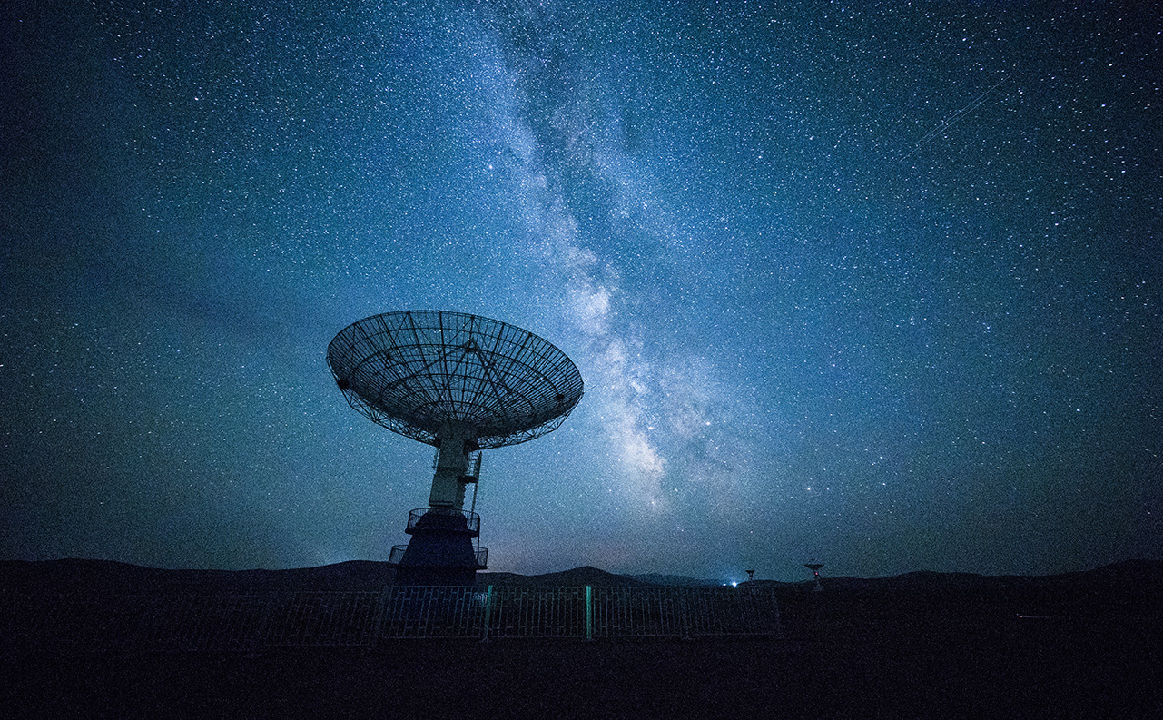
Artificial intelligence
Problem Solving
Algorithm
Automation

Slide 16

Artificial Intelligence
1. What is AI?
Ans: Artificial Intelligence (AI) is a new technical science that studies and develops theories, methods, techniques, and application systems for simulating and extending human intelligence.
2. What are the Relationship between AI, Machine Learning, and Deep Learning?
Ans: Relationship between AI, Machine Learning, and Deep Learning are-
AI: A new technical science that focuses on the research and development of theories, methods, techniques, and application systems for simulating and extending human intelligence.
Machine learning: A core research field of AI. It focuses on the study of how computers can obtain new knowledge or skills by simulating or performing learning behavior of human beings, and reorganize existing knowledge architecture to improve its performance.
Deep learning: A new field of machine learning. The concept of deep learning originates from the research on artificial neural networks. The multi-layer perceptron (MLP) is a type a deep learning architecture. Deep learning aims to simulate the human brain to interpret data such as images, sounds, and texts.
3. What are the Types of AI?
• Strong AI: Machines are considered to be conscious and self-aware, can independently think about problems and work out optimal solutions to problems.
• Weak AI: The weak AI view holds that intelligent machines cannot really reason and solve problems. These machines only look intelligent, but do not have real intelligence or self-awareness

Slide 17
Artificial Intelligence
4. What are the elements of AI?
The four elements of AI are-
Data
Algorithm
Computing power
And Scenario.
5. What is a Neural Network?
Ans: A neural network is a computational model inspired by the way biological neural networks in the human brain work. It is a key component of machine learning and artificial intelligence. Neural networks are designed to recognize patterns and make intelligent decisions based on data.
6. What Is a Convolutional Neural Network?
Ans: A Convolutional Neural Network is a specialized type of deep learning model designed to process grid-like data, such as images. Which extracts hierarchical features from images to recognize objects and patterns. The CNN algorithm consists of several layers that work together to automatically learn relevant features from the input data and make predictions.
7. What Is a Convolutional Layer?
Ans: Convolution layer: a “filter”, sometimes called a “kernel”, is passed over the image, viewing a few pixels at a time (for example, 3X3 or 5X5)

Slide 18
Artificial Intelligence
8. What does pooling require in a convolutional neural network?
Ans: Pooling is the process of further downsampling and reducing the size of the matrix. This allows the network to train much faster, focusing on the most important information in each feature of the image
9. How many types of Polling layers are?
Ans: There are two types of polling layer-
Max polling
Average polling
10. What is a Fully connected layer?
Ans: A Fully connected layer is a traditional multilayer perceptron structure. Its input is a one-dimensional vector representing the output of the previous layers.
11. What are some common activation functions used in neural networks?
Ans: sigmoid function, ReLU (rectified linear unit), tanh (hyperbolic tangent), and SoftMax.
These functions introduce nonlinearity into the model and allow it to learn complex relationships between inputs and outputs
12. Difference Between Sigmoid and Softmax functions?
Ans: The sigmoid function is used for binary classification. The probability sum needs to be 1.
Whereas, the Softmax function is used for multi-classification. The probability sum will be 1.

Slide 19
Artificial Intelligence
13. What is the difference between CNN and ANN?
Ans: CNN (Convolutional Neural Network) and ANN (Artificial Neural Network) are both types of deep learning architectures used for various tasks, but they have some key differences in their structures and applications.
ANN: An Artificial Neural Network is the most basic form of a neural network, where each neuron is connected to all neurons in the previous and subsequent layers. It consists of input layers, hidden layers, and an output layer. feature engineering is typically performed by hand.
CNN: A Convolutional Neural Network is a specialized neural network designed for processing grid-like data, such as images. It consists of three main types of layers: convolutional layers, pooling layers, and fully connected layers. automatically learn hierarchical features from the input data through the convolutional layers.
14. What is the difference between Epoch, Batch, and Iteration in Deep learning?
Ans: Epoch: An epoch is one complete pass through the entire training dataset during the training process.
Batch: A batch is a subset of the training dataset used to update the model's parameters during each training iteration.
Iteration: An iteration refers to a single update of the neural network's parameters based on processing one batch of data.
15. What is the K Nearest Neighbor Algorithm?
Ans: K nearest neighbor algorithm is a classification algorithm that works in a way that a new data point is assigned to a neighboring group to which it is most similar.

Slide 20
Artificial Intelligence
16. What are Support Vectors in SVM? Types of SVM?
Ans: Support Vectors are simply the co-ordinates of individual observation.
There are two different types of SVM-
Simple SVM: Typically used for linear regression and classification problems.
Kernel SVM: Has more flexibility for non-linear data. Because you can add more features to fit a hyperplane instead of a two-dimensional space.
17. What is a Random Forest?
Ans: Random forest algorithm is a supervised classification and regression algorithm.
The higher the number of trees in the forest, greater is the accuracy of the results.
18. What is Data augmentation?
Ans: Data augmentation is a technique to artificially create new training data from existing training data
19. What is Cross-Validation?
Cross-validation is a statistical method used to estimate the skill of machine learning models. The aim of cross-validation is to test the model’s ability to predict a new set of data that was not used to train the model. Cross-validation avoids the overfitting of data.

Slide 21
Artificial Intelligence
20.What is Transfer Learning/Pre-trained models?
Ans: Re-use the model weights from pre-trained models.
Transfer learning has the benefit of decreasing the training time for a neural network model and can result in lower generalization error.
21.What is membership function?
Ans: A membership function (MF) is a curve that defines how each point in the input space is mapped to a membership value between 0 and 1
22. What is the feature of the membership function?
The feature of the membership function is defined by three properties. They are:
Core
Support
Boundary
23. Fuzzification & Defuzzification?
Ans: Fuzzification is the process where the crisp quantities are converted to fuzzy (crisp to fuzzy)
Defuzzification means the fuzzy to crisp conversions The fuzzy results generated cannot be used as such to the applications, hence it is necessary to convert the fuzzy quantities into crisp quantities for further processing.

Slide 22
Artificial Intelligence
24. Why Fuzzy Set?
Ans: It enables one to work in Uncertain and ambiguous situations and solve ill-posed problems or problems with incomplete information
25. What is backpropagation?
Ans: Backpropagation is the neural network training process of feeding error rates back through a neural network to make it more accurate.
26. Applications of Artificial Intelligence(AI)?
Ans: The major applications of AI are
Artificial Intelligence in E-Commerce
AI in Education Purpose
Artificial Intelligence in Robotics
GPS and Navigation
Healthcare
Automobiles
Agriculture
Data Security
Military

Slide 23
THANK YOU
CCE
International Islamic university Chittagong

